Slide 1
Interpreting U(T,V)
Ideal gas molecules don’t see each other. That means there can’t be any volume dependence of the internal energy on volume. In contrast, real gases have intermolecular interactions (esp. at low volume).
Translational and rotational parts of the internal energy are linear functions of $T$ (like $\frac{3}{2}RT$), but vibrational contributions tend to be nonlinear functions of $T$ (i.e., curved).

Slide 2
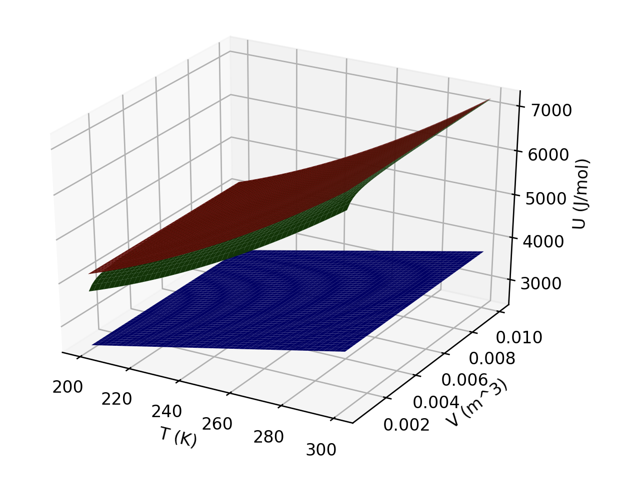
Interpreting U(T,V)
Which of these three gases could be ideal?
Which could be a monatomic gas?

Slide 3
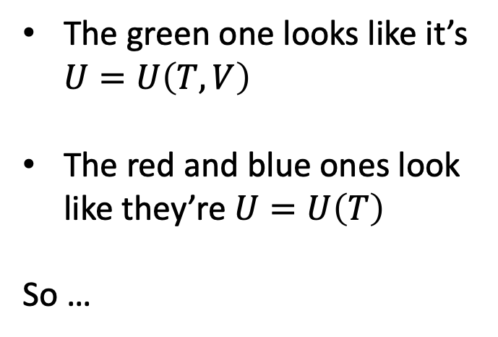
Interpreting U(T,V)
The green one looks like it’s $U=U\left(T,V\right)$
The red and blue ones look like they’re $U=U\left(T\right)$
So …

Slide 4
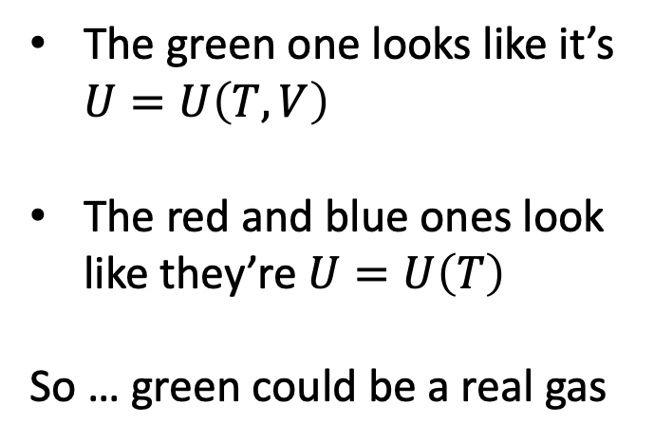
Interpreting U(T,V)
The green one looks like it’s $U=U\left(T,V\right)$
The red and blue ones look like they’re $U=U\left(T\right)$
So … green could be a real gas

Slide 5
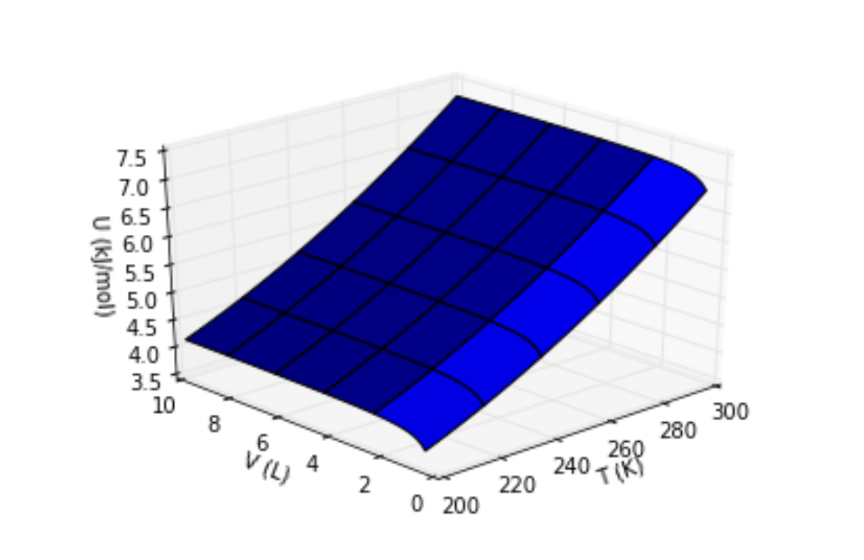

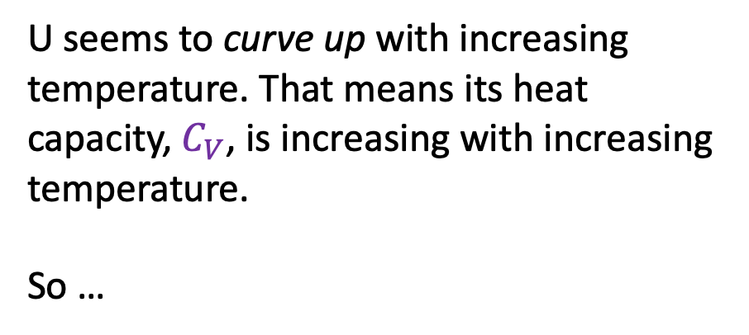

Interpreting the behavior of U in the temperature direction
$$π_{T}$$
$$C_{V}$$
U seems to curve up with increasing temperature. That means its heat capacity, $C_{V}$, is increasing with increasing temperature.
So …

Slide 6
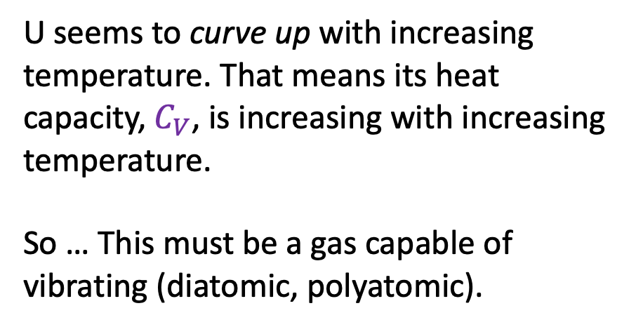
Interpreting the behavior of U in the temperature direction
$$π_{T}$$
$$C_{V}$$
U seems to curve up with increasing temperature. That means its heat capacity, $C_{V}$, is increasing with increasing temperature.
So … This must be a gas capable of vibrating (diatomic, polyatomic).

Slide 7
Interpreting U(T,V)
What kind of gas (real/ideal, monatomic or polyatomic) could this one be?

Slide 8
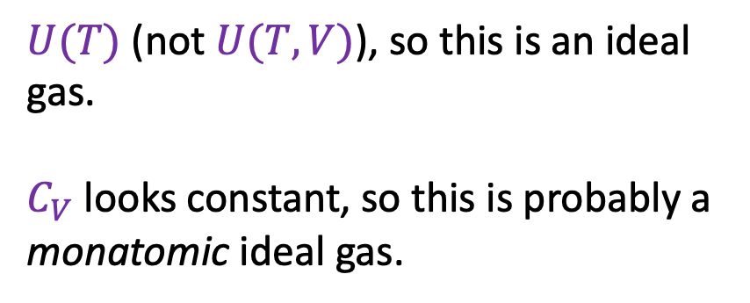
Interpreting U(T,V)
$U(T)$ (not $U(T,V)$), so this is an ideal gas.
$C_{V}$ looks constant, so this is probably a
monatomic ideal gas.
What kind of gas (real/ideal, monatomic or polyatomic) could this one be?

Slide 9

Interpreting the behavior of U in the volume direction
$$π_{T}$$
$$C_{V}$$
Yellow arrow corresponds to confining gas to smaller volumes

Slide 10

Interpreting the behavior of U in the volume direction
$$π_{T}$$
$$C_{V}$$
Why does U dip down at small volumes?
Yellow arrow corresponds to confining gas to smaller volumes

Slide 11
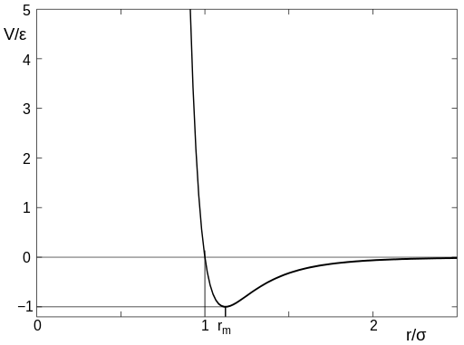
Interpreting the behavior of U in the volume direction
$$π_{T}$$
$$C_{V}$$
Why does U dip down at small volumes?
Potential Energy
Real
Intermolecular distances (d) are getting smaller. So lots of interactions are in the region of negative intermolecular potential energy.
d
Region of negative intermolecular potential energy

Slide 12
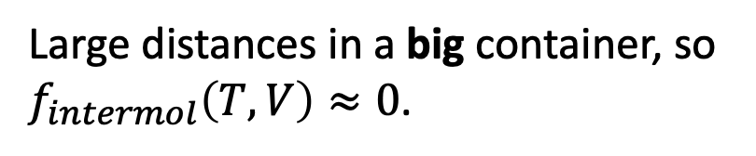
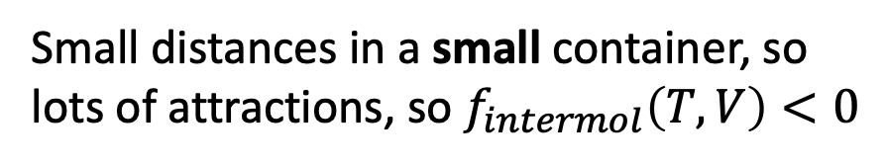
Interpreting the behavior of U in the volume direction
$$π_{T}$$
$$C_{V}$$
Why does U dip down at small volumes?
d
d
d
Large distances in a big container, so $f_{intermol}\left(T,V\right)≈0$.
Small distances in a small container, so lots of attractions, so $f_{intermol}\left(T,V\right)<0$

Slide 13
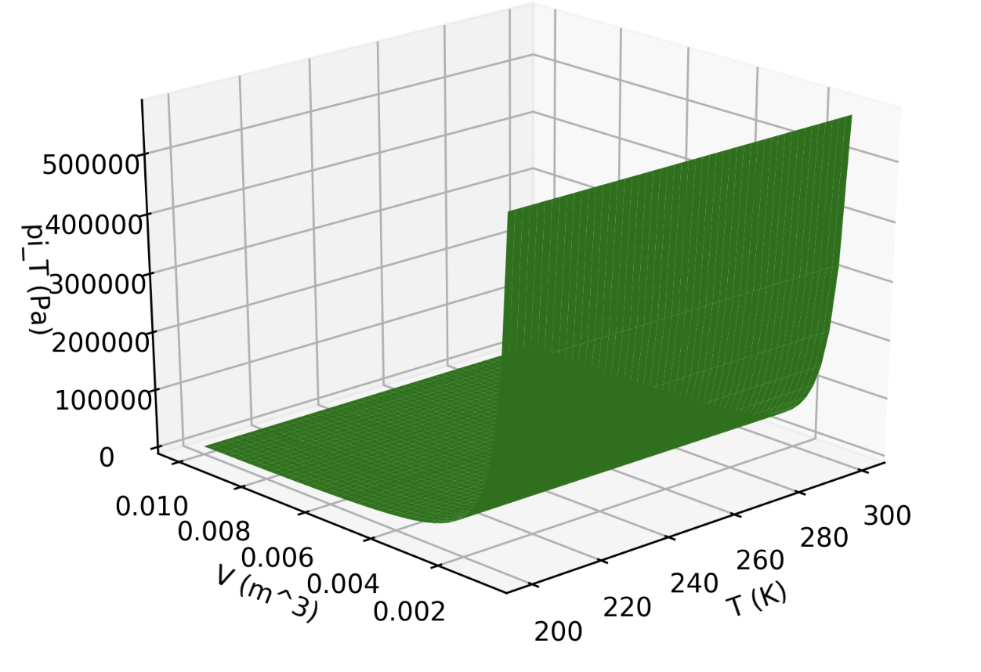
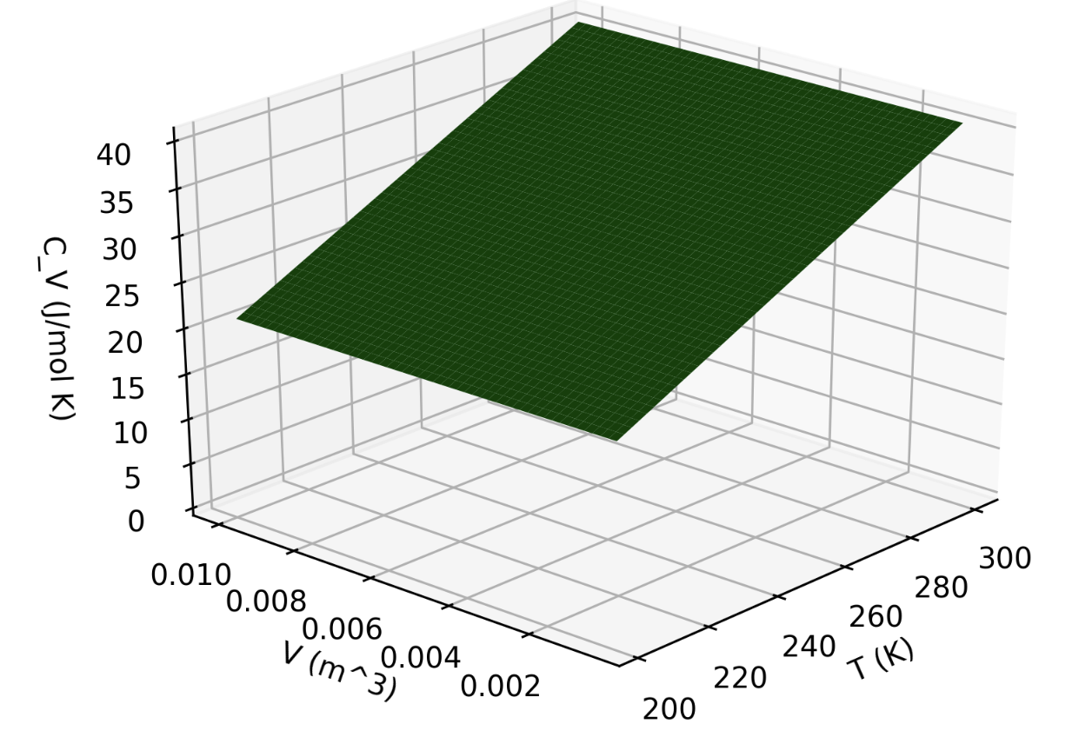

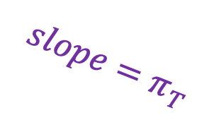


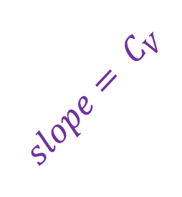

Differential calculus gets us $C_{V}$ and $π_{T}$
$$π_{T}(T,V)$$
$$U(T,V)$$
$$slope=π_{T}$$
$${slope= C}_{V}$$
$$C_{V}(T,V)$$

Slide 14
When to use numerical or analytical methods to get $C_{V}$ and $π_{T}$
If you have a discrete representation of $U(V,T)$, you can take a numerical derivative in Python (using dF_dx and dF_dy).

Slide 15
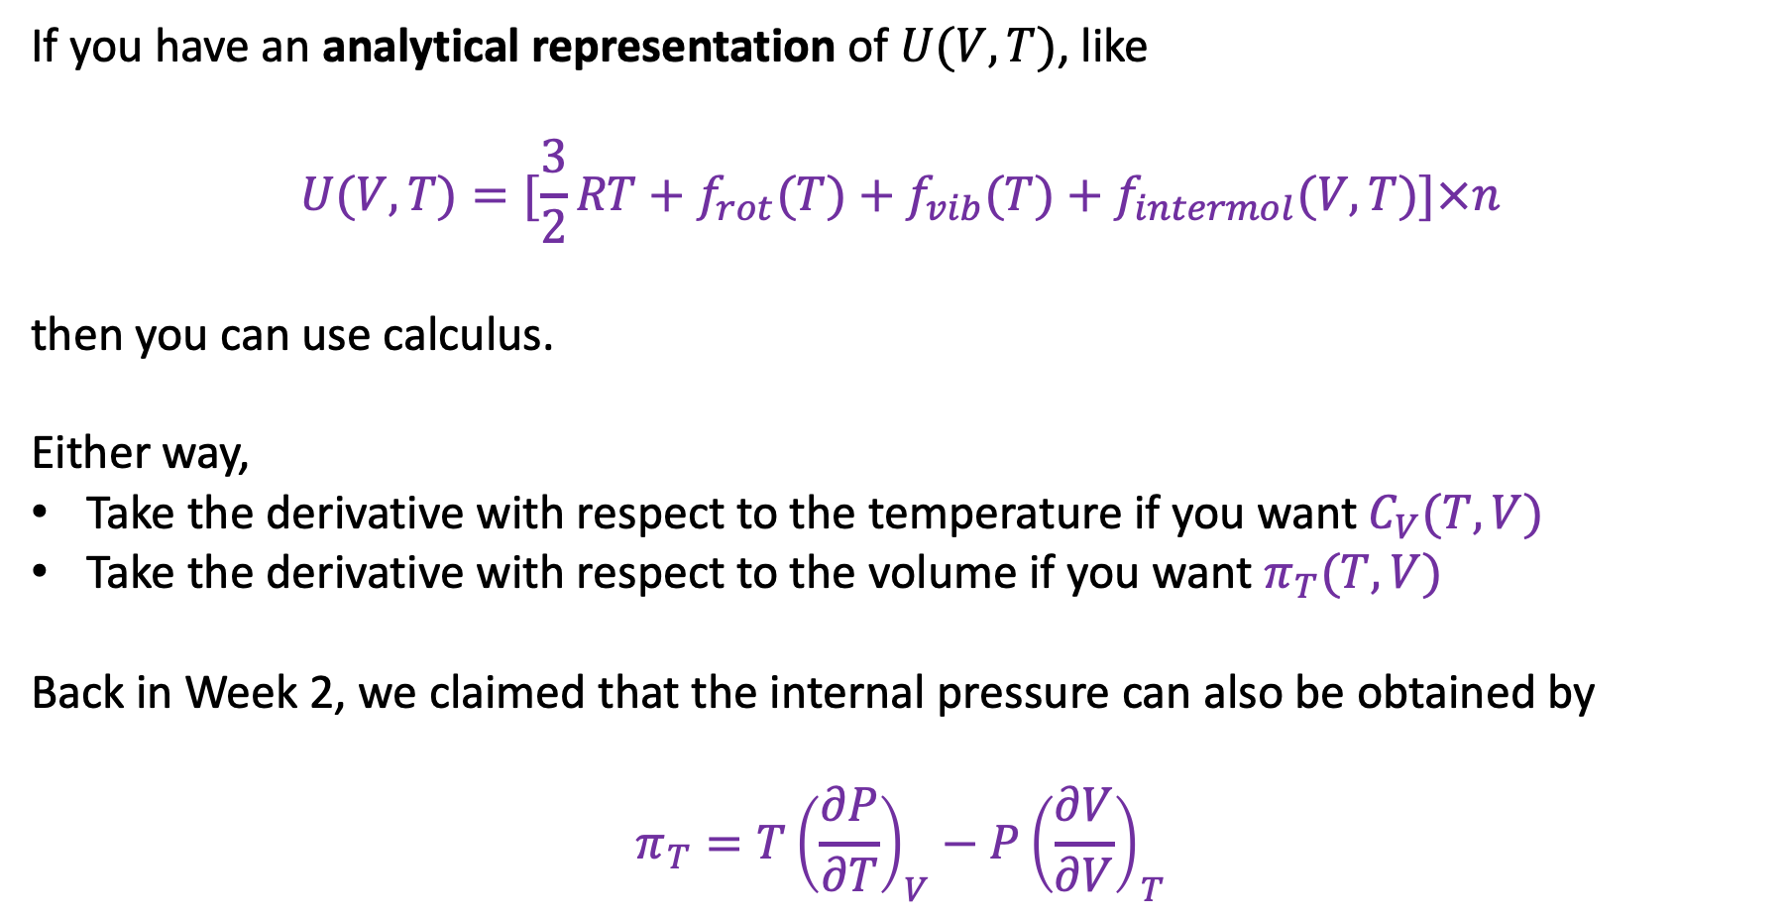
When to use numerical or analytical methods to get $C_{V}$ and $π_{T}$
If you have an analytical representation of $U(V,T)$, like
$$U(V,T)=[\frac{3}{2}RT+f_{rot}(T)+f_{vib}(T)+f_{intermol}(V,T)]×n$$
then you can use calculus.
Either way,
Take the derivative with respect to the temperature if you want $C_{V}(T,V)$
Take the derivative with respect to the volume if you want $π_{T}(T,V)$
Back in Week 2, we claimed that the internal pressure can also be obtained by
$$π_{T}=T{\left(\frac{∂P}{∂T}\right)}_{V}−P{\left(\frac{∂V}{∂V}\right)}_{T}$$

Slide 16
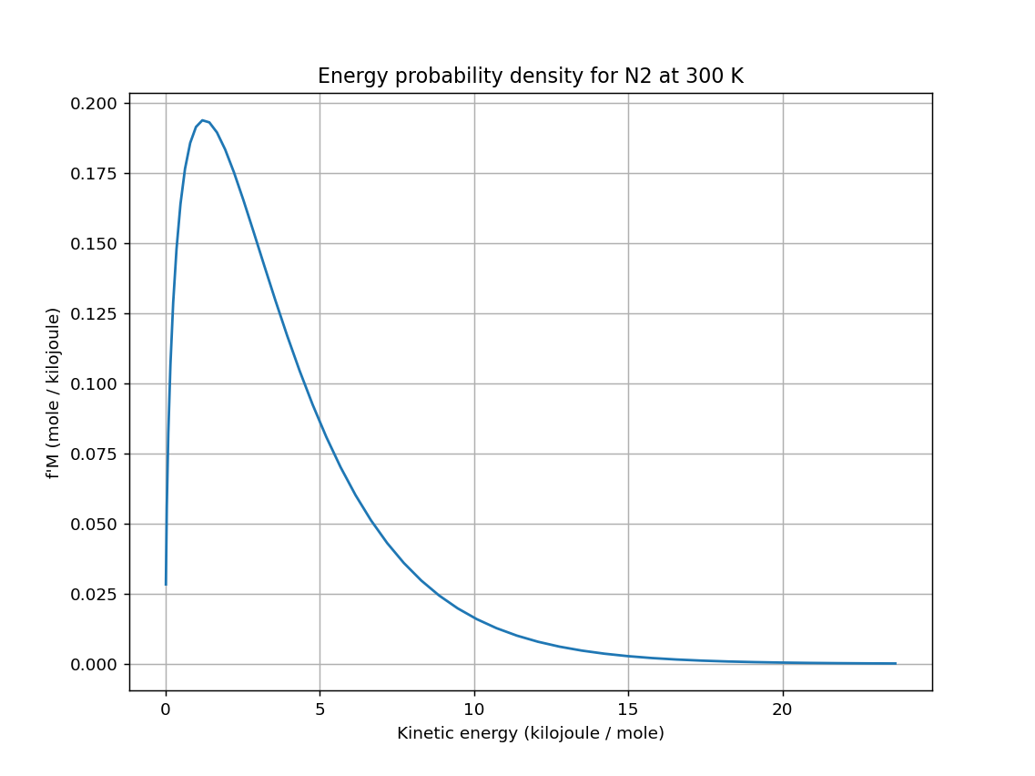
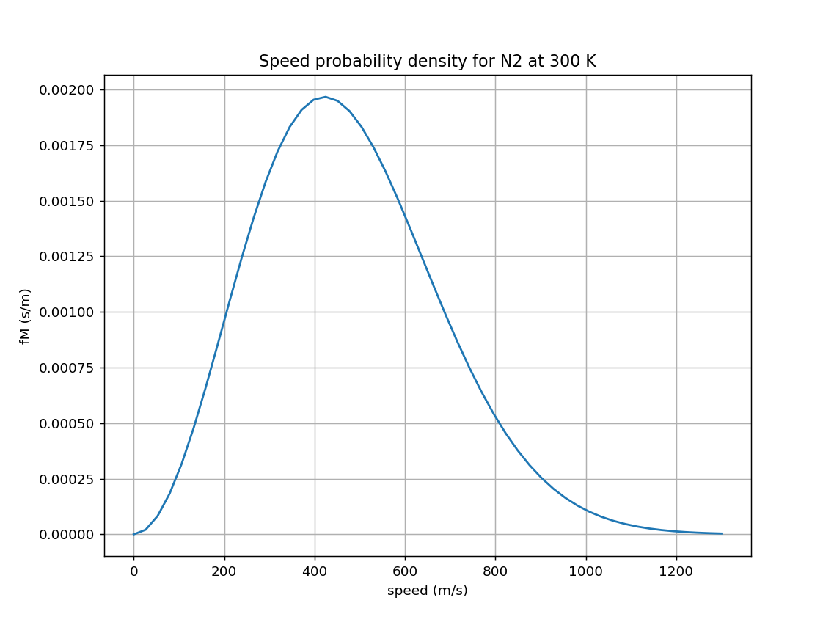


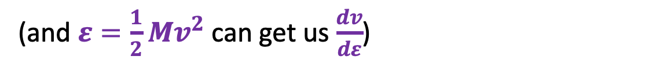
Transforming from one probability density to another
OK … what if we wanted to think about all this in terms of kinetic energy instead of speed?
${f′}_{M}\left(T,ε\right)=f_{M}\left(T,v\right)\frac{dv}{dε}$
$f_{M}\left(T,v\right)$
${f′}_{M}\left(T,ε\right)$
$$∆ε$$
$$∆v$$
(and $ε=\frac{1}{2}Mv^{2}$ can get us $\frac{dv}{dε}$)

Slide 17
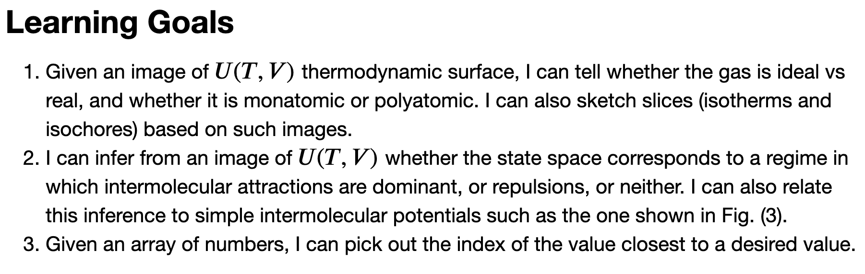
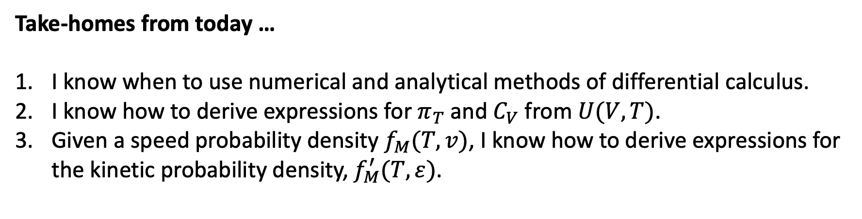
Take-homes from today …
I know when to use numerical and analytical methods of differential calculus.
I know how to derive expressions for $π_{T}$ and $C_{V}$ from $U(V,T)$.
Given a speed probability density $f_{M}(T,v)$, I know how to derive expressions for the kinetic probability density, $f_{M}^{′}(T,ε)$.

Slide 18
Now might be a good time to finish any unfinished CGI work

